Slide 1


December 17, 2021
MS Teams
PASSWORD STRENGTH CLASSIFICATION
Submitted By:
Abhay Chaudhary -19BCE7290
Mohammed Habeeb -19BCE7583
Motiki Pavan Anudeep -19BCD7067
Anagani Pavan Krishna -19BCD7209
Under the Guidance of
Dr Gopikrishnan S

Slide 2


ABSTRACT
Passwords can be used to access certain information, an account, a computer system, or a secure location. A single user can have several password-protected accounts. According to research, individuals prefer to use similar passwords for several accounts with minimal variation. Once a single password is discovered, it may be used to access various accounts. This article examines password security, taking a thorough look at what goes into creating a strong password and the difficulties of cracking one. The following parts cover related studies and demonstrate the many facets of password security, neglected weaknesses, and the relevance of passwords that are commonly overlooked visually and mathematically. This document helps to reduce the danger posed by individuals looking to reveal sensitive digital information.

Slide 3



INTRODUCTION
Since the emergence of technology, passwords have become a significant element of people's lives. Since the dawn of technology, they have played a critical role in safeguarding our digital lives online. In a world where information security is becoming increasingly important, every organization's requirement for user access control is vital.

Slide 4

RELATED WORK AND BACKGROUND
Significant research has been done on passwords, security, authentication methods,and options beyond passwords. More securealternatives to passwordsexist. But as Herley et al. stated in their paper, there are several barriers to moving beyond passwords, such as diversity of requirements, user reluctance and usability, individual controlof end-user systems etc. Today, alphanumeric passwords are still the most common mode of authentication; hence the focus rests on improvingthe securityof passwords and their authentication.
The dataset we chose can be found on Kaggle.com. The credentials utilized in the research came from the internet breach of 000webhost. The password's strength was determined using a tool developed by Georgia Tech University called PARS, which includes all commercial password metres.
All of the passwords were supplied to the device, and it generated new files for each commercial password strength metre.

Slide 5

Let the length of the password that is to be cracked be N.
N^^^^^^^^k
ASPECTS OF PASSWORD SECURITY
The possible candidates for each character of the passwordare 26. Let the character set consist of k characters for a more generic case.

Slide 6




PROBLEM DEFINITION
The most important words or phrases used to protect someone's identity and data are passwords.
They serve as your first line of defence against illegal access to your accounts and personal data.
Judging the strength of a password simply by glancing at it is challenging
We used a database of existing passwords with specified strengths based on settings provided by commercial password metres.

Slide 7
METHODOLOGY
There are eight columns in the dataset
Gathering Data
The first column is called 'Id,' and it is unique.
The passwords are in the second column.
The password length is listed in the third column.
The percentage of capital, lowercase, numerals, and special characters in the password is represented in the fourth, fifth, sixth, and seventh columns, respectively.
The password's strength is shown in the last column, ranging from 0-Weak to 1-Medium to 2-Strong.

Slide 8
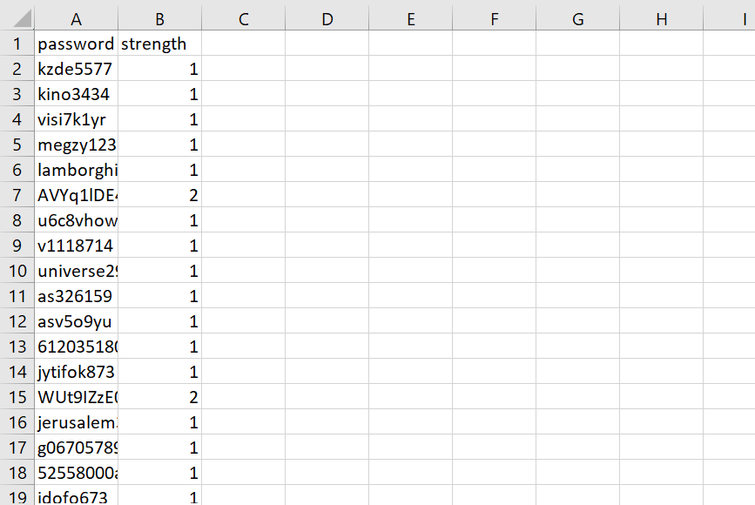
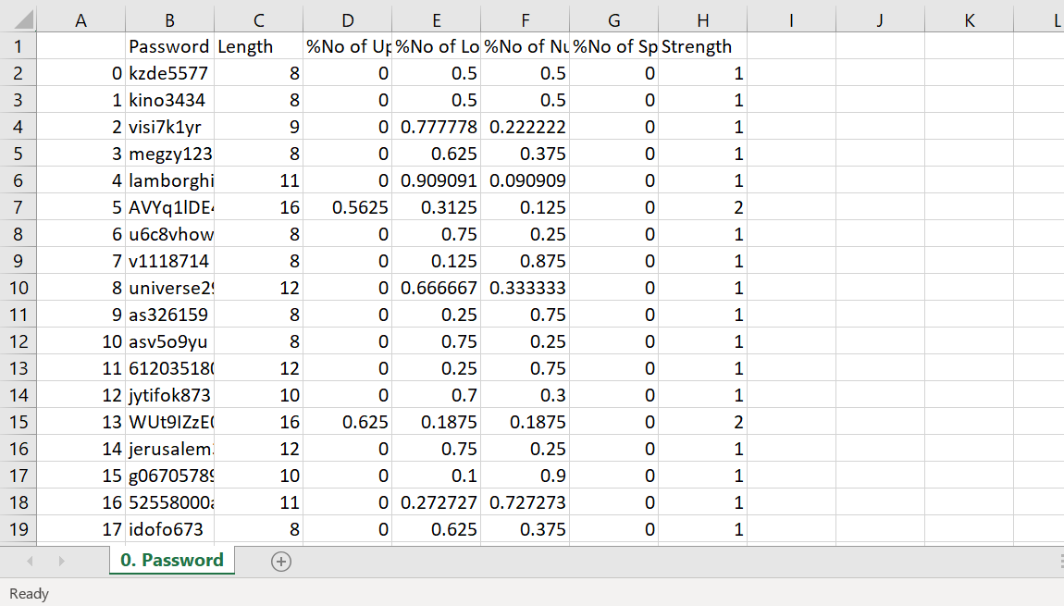
METHODOLOGY
Initially, our dataset from kaggle only has passwords and their strength but then we extracted various details from the password to process and analyse the data as intended.

Slide 9
METHODOLOGY
Pre processing
There are seven lakh rows do we chose a sample of 2 lakh rows for our study because the number of rows was enormous and we didn't have the capacity to analyze the entire dataset. The Sr No column and the column holding the passwords themselves were deleted from our dataset. Our second difficulty was that our dataset had no missing values. For our algorithms to work, we needed to modify the type of columns to right columns in the dataset

Slide 10
ML MODELS
Support Vector Machine (both linear and radial kernels
Naïve Bayes Classifier
Random Forest

Slide 11
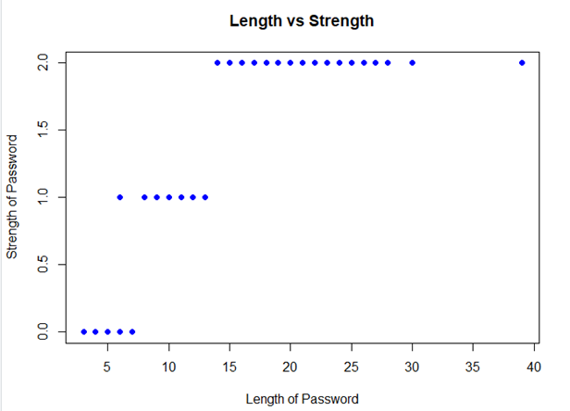
Fig: Basic Analysis from Dataset- Length vs Strength of the Password

Slide 12
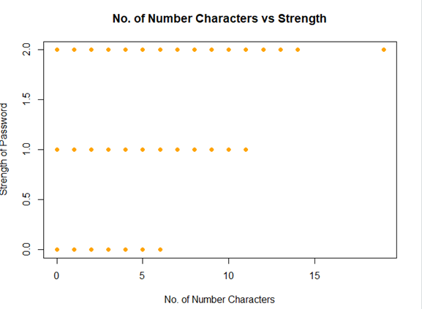
Fig: Basic Analysis from Dataset - No. of Number Characters vs Strength of the Password

Slide 13
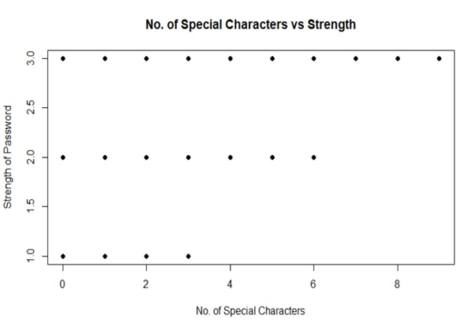
Fig: Basic Analysis from Dataset – Number of Special Characters vs Strength of the Password

Slide 14
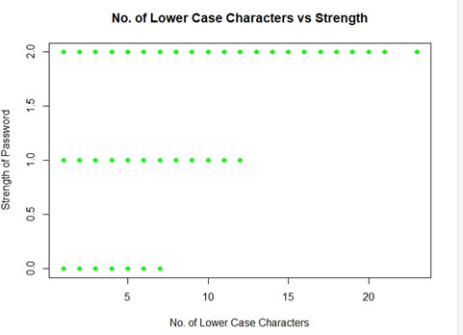
Fig: Basic Analysis from Dataset – No. of Lower Case Characters vs Strength of the Password

Slide 15
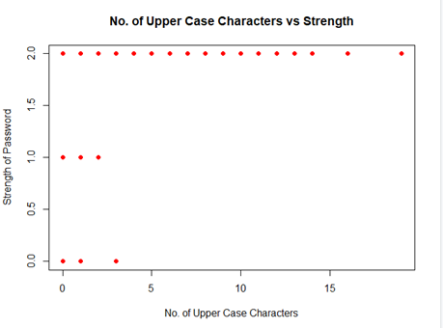
Fig: Basic Analysis from Dataset – No. of Upper Case Characters vs Strength of the Password

Slide 16
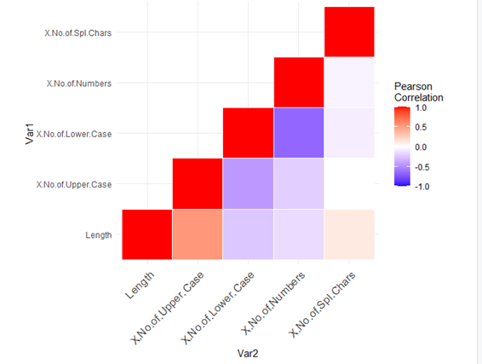
Fig : Correlation Analysis

Slide 17
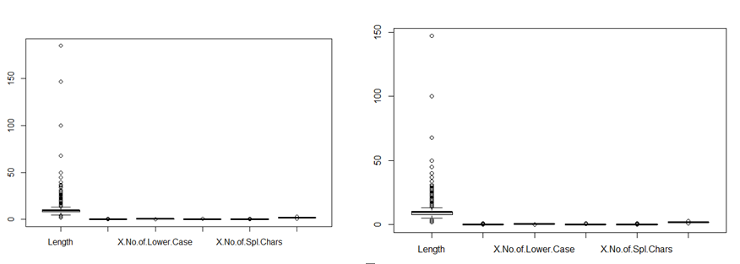
Fig : Boxplot Before and After Outliers

Slide 18
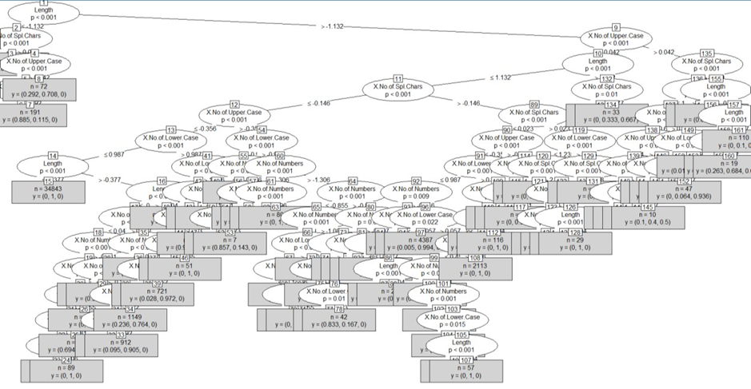
Fig : Decision Tree Using Random Forest

Slide 19

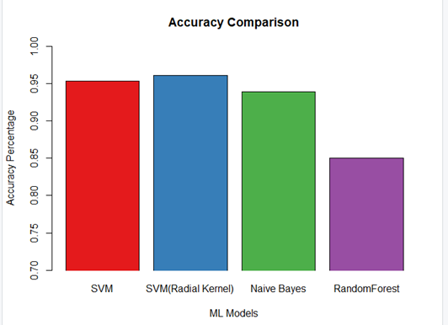
ACCURACY
When we compare the accuracy of all the methods, we find that SVM – radial has the best accuracy, followed by SVM and nave Bayes, all of which are close to 95 per cent. The accuracy of random forest is 85 per cent. The SVM model should be used in this case.

Slide 20
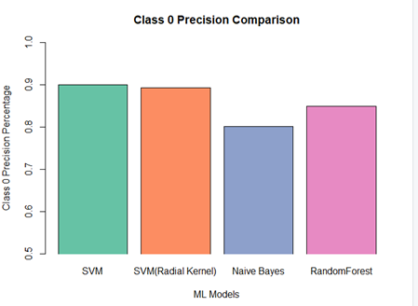
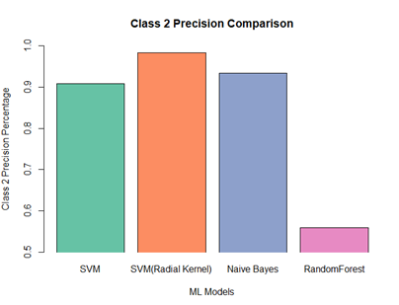
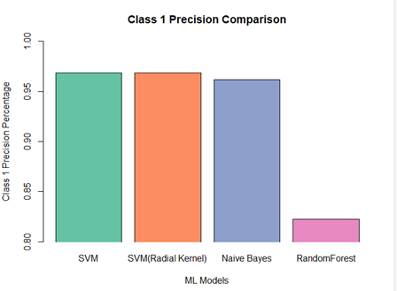
PRECISION
Precision (also known as positive predictive value) refers to the percentage of relevant results older than a certain age. For all of the classes, we can observe that SVM (both) have a good level of accuracy. For classes 1 and 2, Nave Bayes has high accuracy. However, for class 0, it fails. Only class 0 has a high level of accuracy, whereas the rest of the classes fail.
All of the algorithms have good accuracy, except for random forest for class 2, which has a lot of false positives.

Slide 21
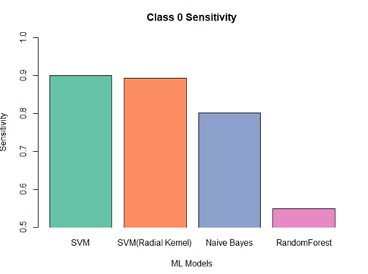
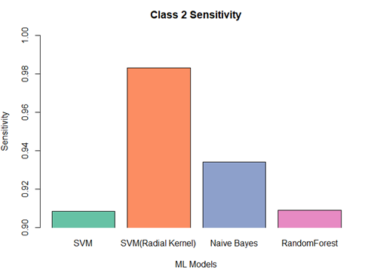
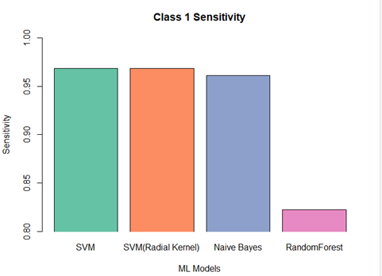
RECALL
Recall (also called Sensitivity) refers to the percentage of total relevant results correctly classified by the algorithm.
SVM radial is better than the rest as it shows high recall for all the classes. SVM linearshows consistent recall for all classes at 0.9. Naïve Bayes and random forest show comparatively low recall than others.

Slide 22
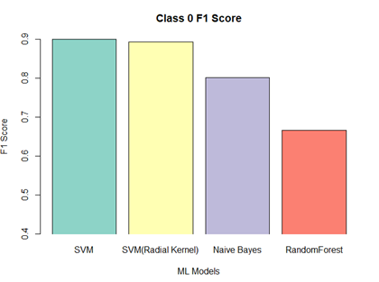
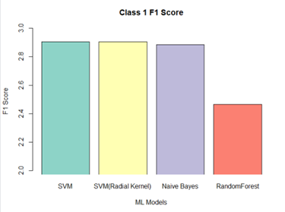
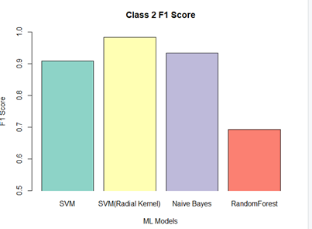
F1 SCORE

Slide 23
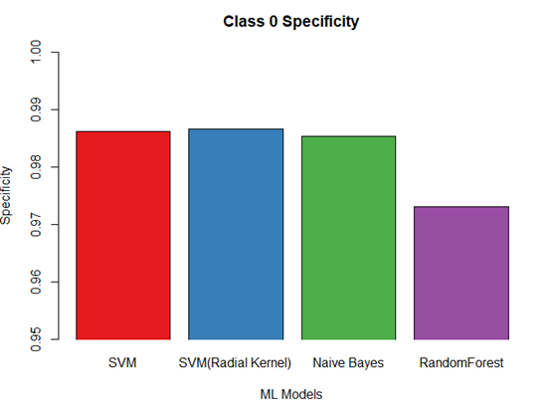
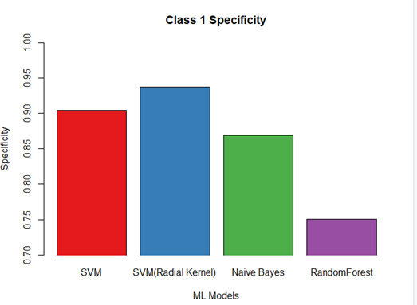
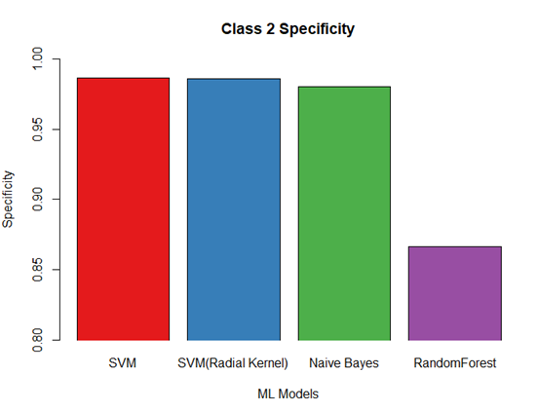
SPECIFICITY

Slide 24
CONCLUSION
We used various machine learning models to classify the passwords depending on their strength in our dataset. We can reasonably claim that SVM (radial) is the best method, with the highest accuracy and F1 score, followed by SVM and the Naive Bayes classifier. On the other hand, random Forest lags because it successfully classifies two classes but fails to categorize one. One of the reasons for this is that we utilize the party random forest library, which reduces the dataset to run compared to the standard libraries.

Slide 25

THANK YOU FOR LISTENING!

